Slide 1
NEXT HIKES IT SOLUTIONS
Vincy Mehta
Industry Annual revenue prediction

Slide 2
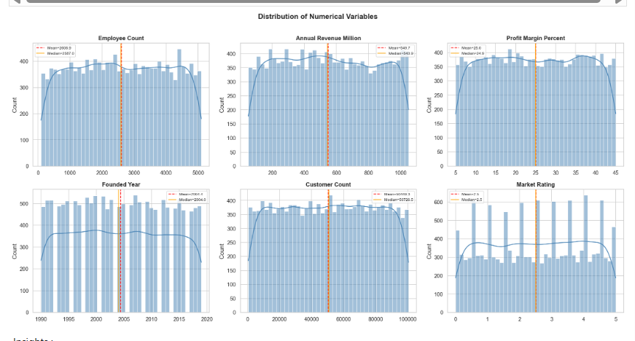
Insights :
Across almost all metrics—Employee Count, Revenue, and Customer Count—the data shows a uniform distribution. This means the business or industry has a very consistent spread of small, medium, and large-scale operations without any extreme "gaps.“
Companies range from very small (near 0 employees) to large (5,000 employees).
The "Market Rating" shows frequent peaks at whole numbers (1, 2, 3, 4, 5). The overall average rating is 2.5, which is exactly in the middle. This suggests there is significant room for improvement in customer satisfaction to push that average toward a 4 or 5.

Slide 3
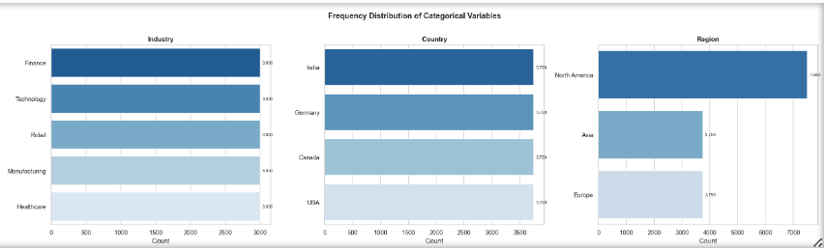
Insights :
The dataset is perfectly balanced across five key sectors: Finance, Technology, Retail, Manufacturing, and Healthcare.
Each industry has exactly 3,000 entries. This indicates a highly diversified business portfolio or study, meaning the overall performance isn't overly dependent on a single sector.
Each country shows a count of approximately 3,750, suggesting that the business has successfully established an identical scale of operations or data collection in each of these diverse international markets.
North American Focus: While the country-level data is balanced, the North America region shows a massive lead with 7,500 entries.
North America has double the presence of Asia (3,750) or Europe (3,750). This implies that North America is the primary hub for the business.

Slide 4
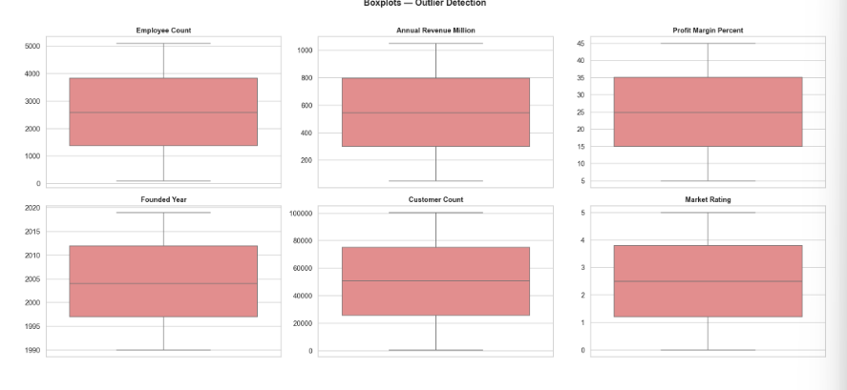
No Statistical Outliers: (0 Outliers)
Across all six subplots (Employee Count, Annual Revenue Million, Profit Margin Percent, Founded Year, Customer Count, and Market Rating), there are no individual data points (dots or fliers) plotted outside the whiskers.

Slide 5
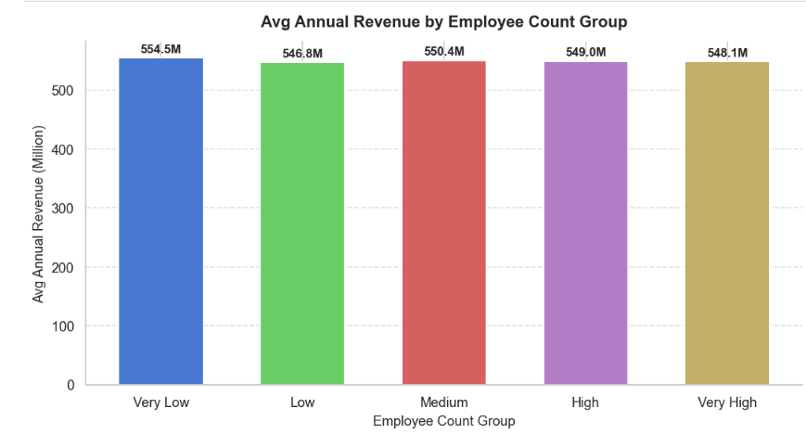
Insights :
The "Very Low"(blue) employee group actually generates the highest average revenue ($554.5M).
This suggests that smaller teams in this dataset are highly efficient or represent high-value niche businesses.
The revenue for the largest groups ($548.1M) is slightly lower than that of the smallest groups.
The business model appears remarkably stable. The gap between the highest-performing group (Very Low) and the lowest (Low) is only about $7.7M, a variance of less than 1.5%.

Slide 6
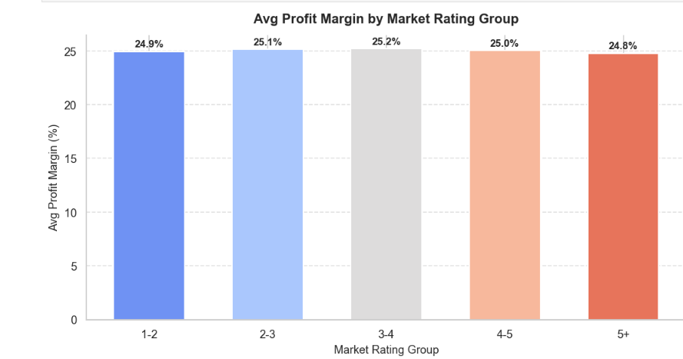
Insights :
Based on the bar chart for Avg Profit Margin by Market Rating Group.
Profit margins are incredibly consistent across all market rating groups. Every single category maintains a margin of approximately 25%, regardless of its rating.
The 3-4 rating group shows the highest average profit margin at 25.2%, though the lead is very slim.
There is no clear correlation between a higher market rating and a higher profit margin. For example, the 5+ group (the highest rating) actually has the lowest average margin at 24.8%.
From a business planning perspective, the data suggests that profit outcomes are highly predictable. The total variance between the highest and lowest groups is only 0.4%.

Slide 7
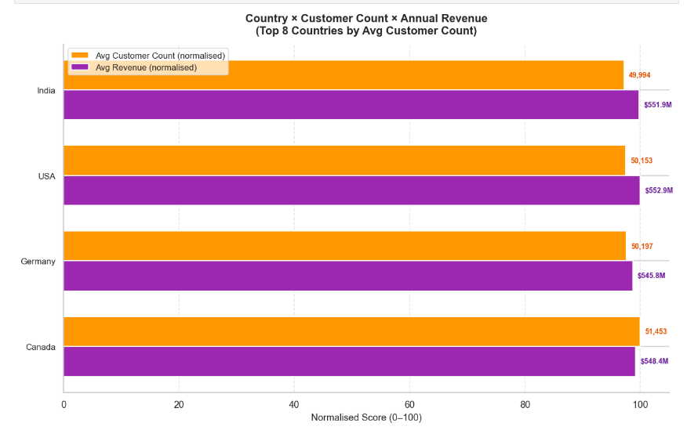
Insights :
Canada has the highest average customer count among the top countries, with 51,453 customers.
The USA generates the highest average revenue at $552.9M. This suggests that American customers may have a higher "average spend" or lifetime value.
India has the lowest customer count in this specific group (49,994) but generates the second-highest revenue ($551.9M). This indicates a very efficient business model in India, earning more money per customer than Germany or Canada.
Germany sits in the middle for customer volume (50,197) but has the lowest average revenue in this set ($545.8M).

Slide 8
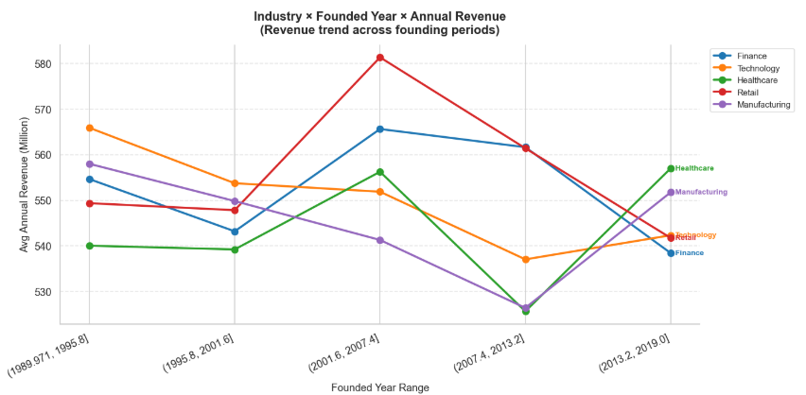
Insights :
Based on the line chart for Industry × Founded Year × Annual Revenue.
Companies in the Retail sector founded between 2001.6 and 2007.4 reached the highest average revenue in the entire chart, peaking at over $580M.
While many industries saw a decline in recent years, Healthcare shows a strong upward trend for companies founded between 2013.2 and 2019.0, becoming the top-performing sector for that specific period.
Technology companies founded in the earliest period (1989.9–1995.8) started with very high revenue, but there has been a general downward trend for newer Tech firms founded in subsequent years.

Slide 9
Feature Engineering
New Feature | Formula | Business Meaning
company age | max year of dataset − founded year | Captures company maturity; older firms often behave differently in revenue and risk
rev_per_employee | annual revenue ÷ (employee count + 1) | Efficiency metric — how much revenue each employee generates
rev_per_customer | annual revenue ÷ (customer count + 1) | Monetization signal — average spend per customer
emp_x_rating | employee count × market rating | Interaction term: combines scale with market sentiment
profit_x_rating | profit margin % × market rating | Weights profitability by how the market perceives the company
Note : The +1 in denominators prevents division-by-zero when count is 0.

Slide 10
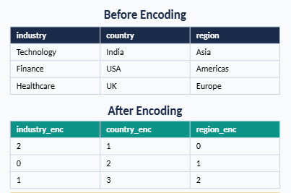
Categorical Encoding
ML models require numeric inputs. Columns like industry, country, and region contain text — Label Encoding converts each unique category to an integer.

Slide 11
split the data & model selection (XGBoost)
Dataset Preparation (X / y Split)
Define features and target:
TARGET = the column you want to predict (e.g. annual_revenue_million)
FEATURES = all remaining columns except the target
X = the feature matrix passed to the model
y = the target vector the model learns to predict
Three models were tuned using cross-validation and evaluated on a held-out test set:
Model | CV R² | Test R² | RMSE | MAE | MAPE
XGBoost | 0.9975 | 0.9980 | 12.75 | 7.69 | 1.77%
Gradient Boosting | 0.9965 | 0.9967 | 16.43 | 11.87 | 2.89%
Random Forest | 0.9673 | 0.9708 | 49.08 | 32.57 | 8.40%

Slide 12
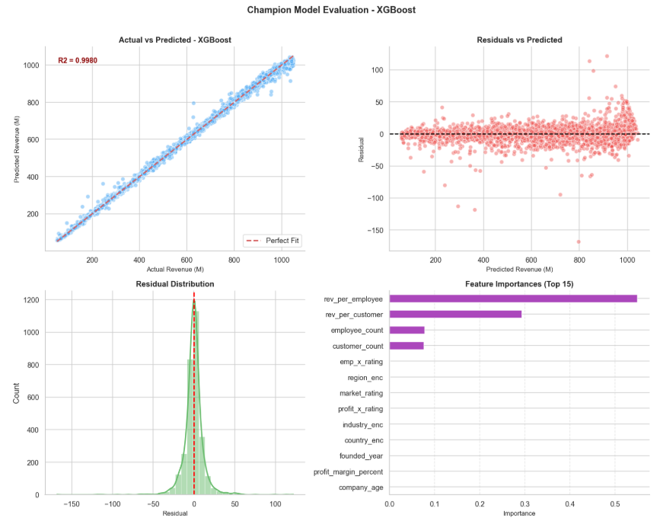
Near-Perfect Fit: The Actual vs Predicted plot shows the data points tightly clustered around the red dashed "Perfect Fit" diagonal line.
High Variance Explained: The model achieves an $R^2$ score of 0.9980, meaning it successfully explains 99.8% of the variance in revenue.
Primary Driver: rev_per_employee is by far the most dominant feature, holding an importance score above 0.55.
Secondary Driver: rev_per_customer is the second most critical feature (around 0.29).

Slide 13
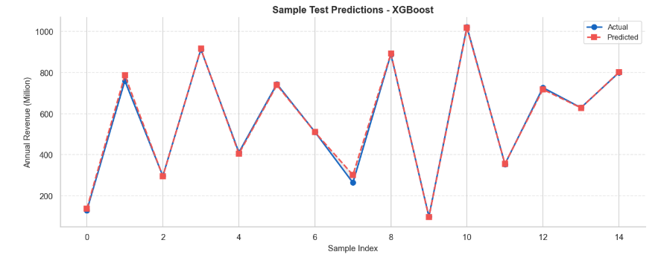
The model demonstrates an exceptional ability to capture the variance and trends across the sample test data. The red dashed line representing Predicted values tightly mirrors the blue solid line representing Actual values.
Overall, this visualization confirms that the high performance seen in your evaluation metrics carries over perfectly to individual test samples,

Slide 14
:
Conclusion
1. Data Overview
The dataset is well-balanced across 5 industries (Finance, Technology, Retail, Manufacturing, Healthcare) and multiple countries, with each sector having exactly 3,000 entries. There are zero statistical outliers, making the data highly reliable for analysis.
2. Key Business Insights
Small teams, big revenue: Companies with "Very Low" employee counts generate the highest average revenue (~$554.5M), indicating lean but efficient business models.
Profit margins are stable: Across all market rating groups, profit margins hold steady at ~25%, regardless of ratings — making revenue outcomes highly predictable.
Geography matters: The USA leads in average revenue ($552.9M), while India shows the most efficient model (high revenue with fewer customers). North America overall dominates with double the presence of Asia or Europe.
3. Industry Trends
Retail companies founded between 2001–2007 peaked at over $580M in revenue.
Healthcare is on an upward trajectory for companies founded after 2013.
Technology older firms performed better; newer tech companies show a declining revenue trend.
4. ML Model Performance
Three models were tested, and XGBoost was the winner:
XGBoost explains 99.8% of revenue variance with only ~1.77% average prediction error.
5. Top Revenue Drivers
The two most critical features driving revenue prediction are:
Revenue per Employee (importance score > 0.55) — the #1 driver
Revenue per Customer (~0.29) — the #2 driver
Overall Takeaway: The model built successfully predicts annual industry revenue with near-perfect accuracy. Operational efficiency (revenue per employee/customer) is the strongest predictor of business revenue, and the XGBoost model is ready for real-world deployment.

